Slide 1
Humoral immunity
B cell

Slide 2
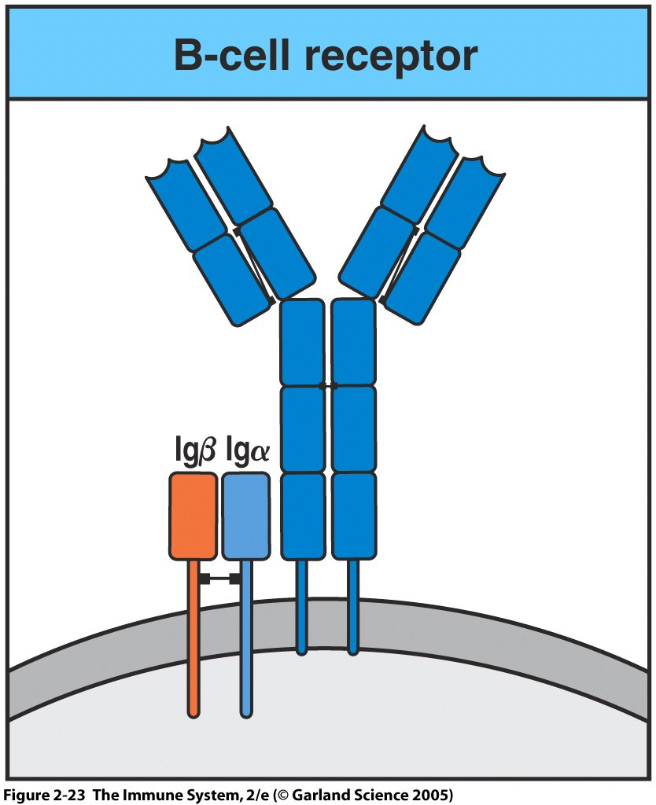
Figure 2-23

Slide 3
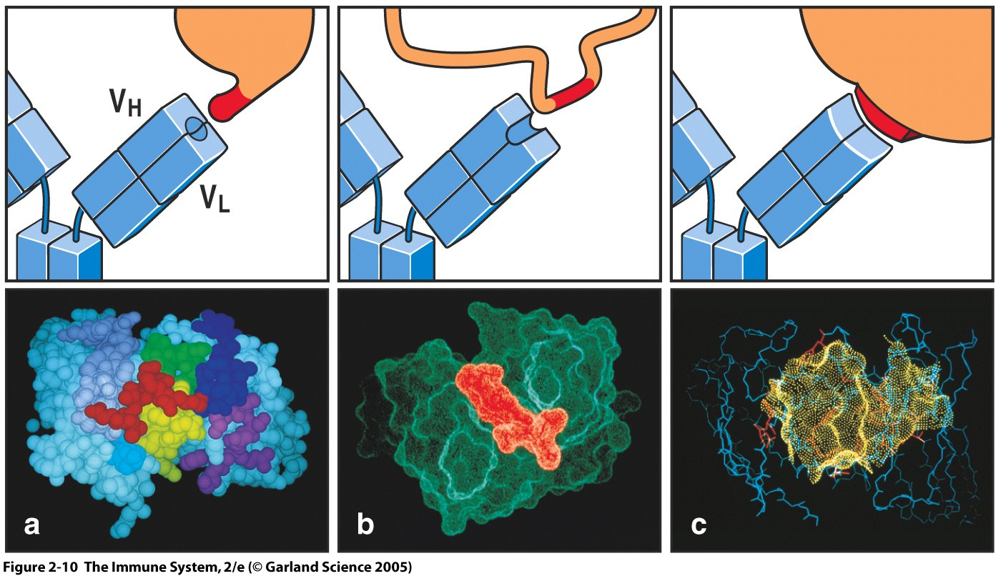
Figure 2-10
Interaction between antibody and antigen is based on
Hydrogen bonding
Hydrophobic interactions
Better fit = stronger bond

Slide 4
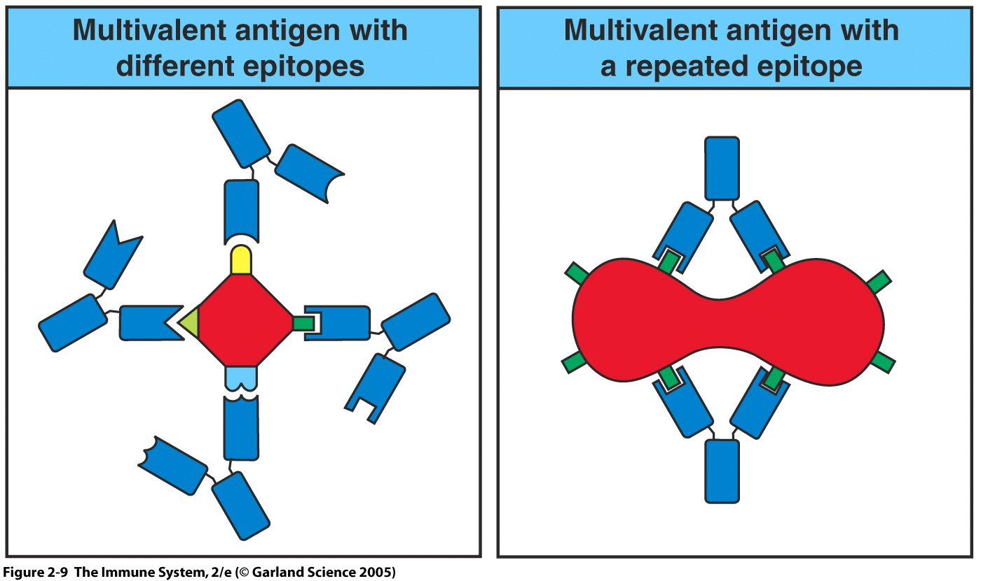
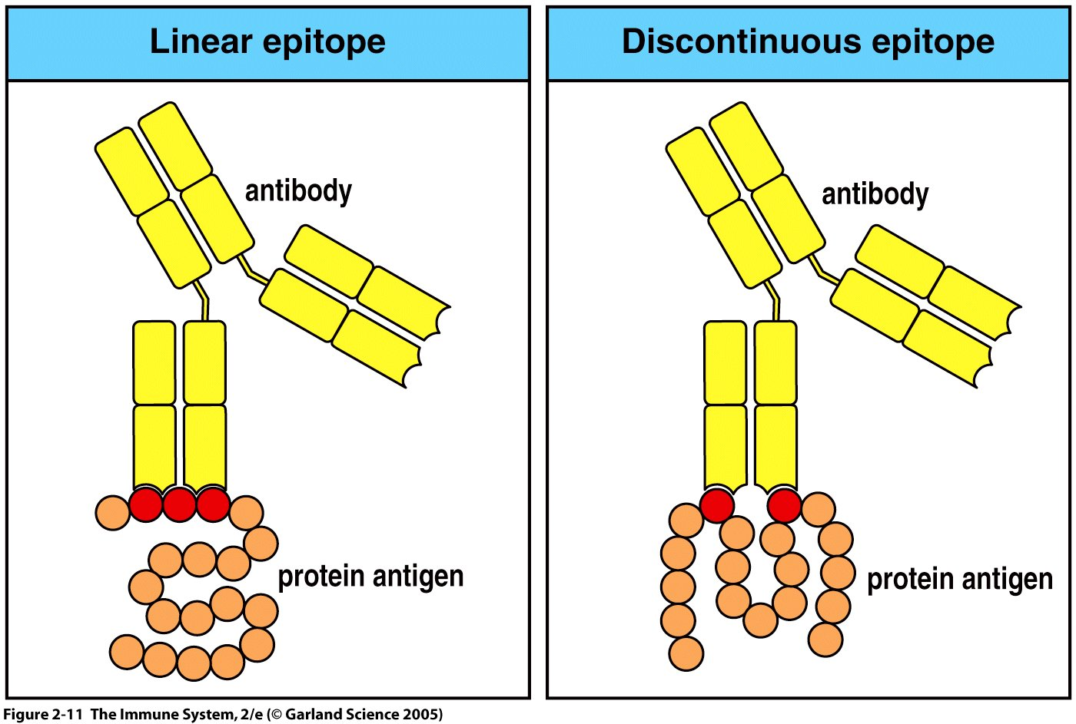
Figure 2-9

Slide 5
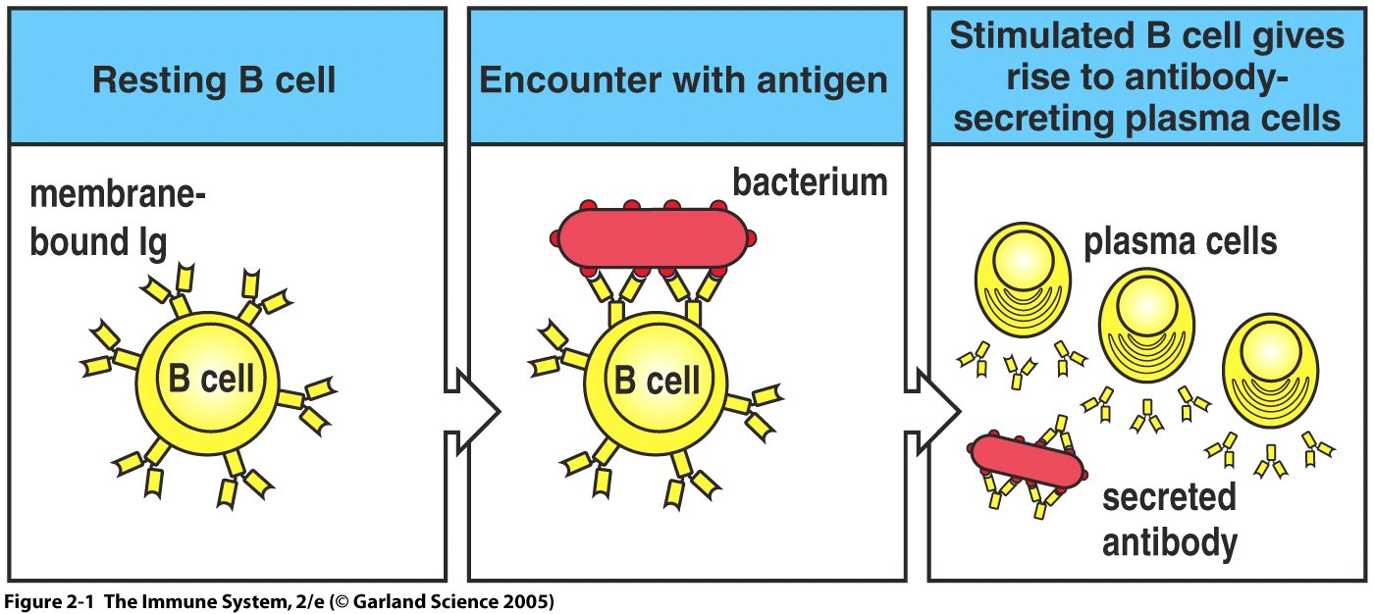
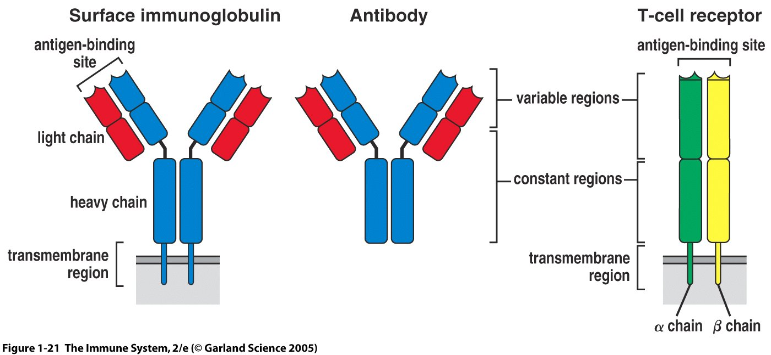
Figure 2-1

Slide 6
Signal 1 for B cells is the crosslinking of
Two BCRs on the surface of a naïve B cell.
B cell
B cell
Signal 2 for B cells is produced by an
activated T helper cell by the production
of specific cytokines.

Slide 7
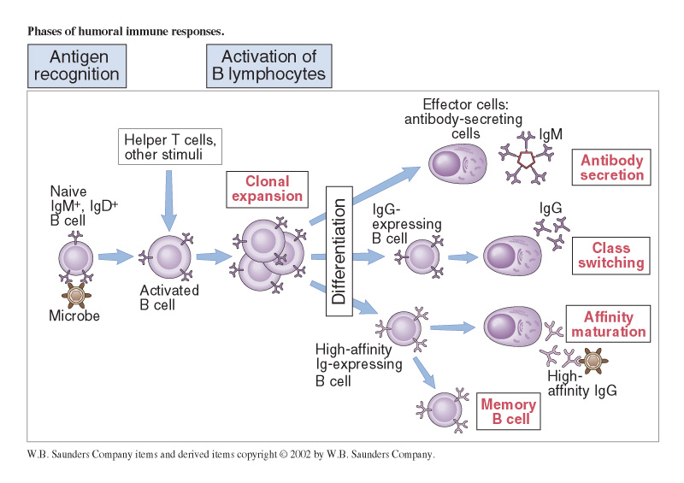
In order for B cells to become fully activated it needs T cell help from a CD4 cell.

Slide 8
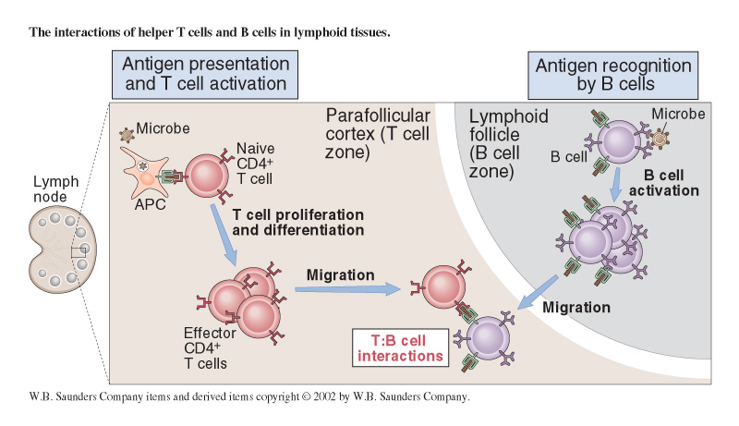

Slide 9
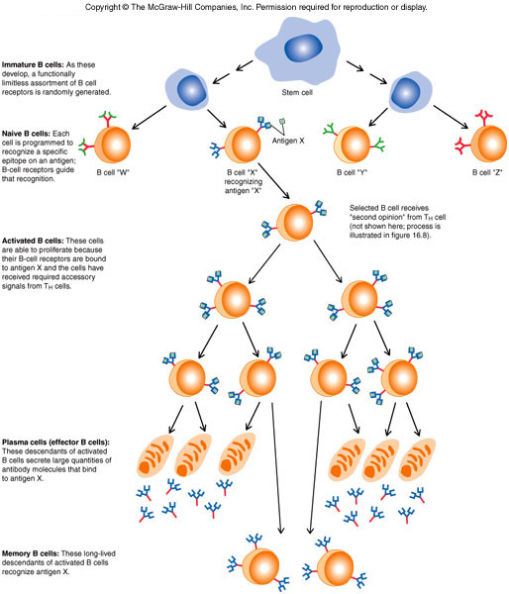

Slide 10
CD40L/CD40
T cell/B cell
4
Th2 cell
B cell
4
4
memory
Plasma cell

Slide 11
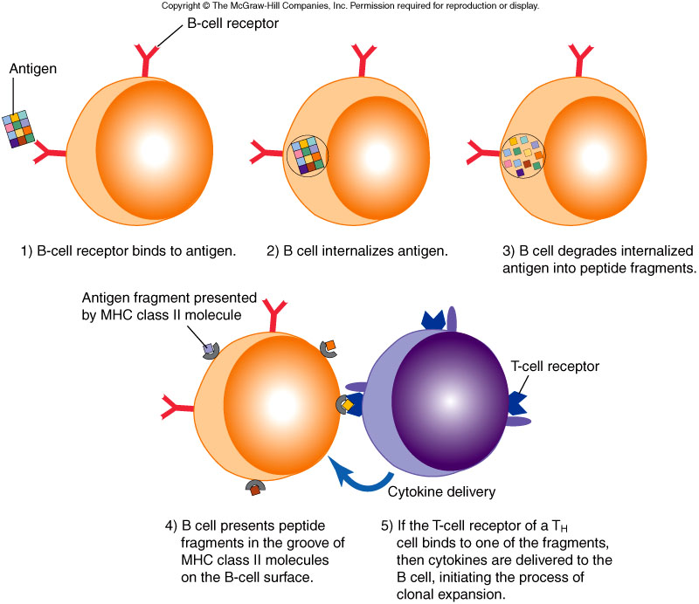

Slide 12
CD40L/CD40
T cell/B cell
4
Th cell
4
B cell
4
memory
Plasma cell

Slide 13
B cell
No activation
Not able to
crosslink

Slide 14
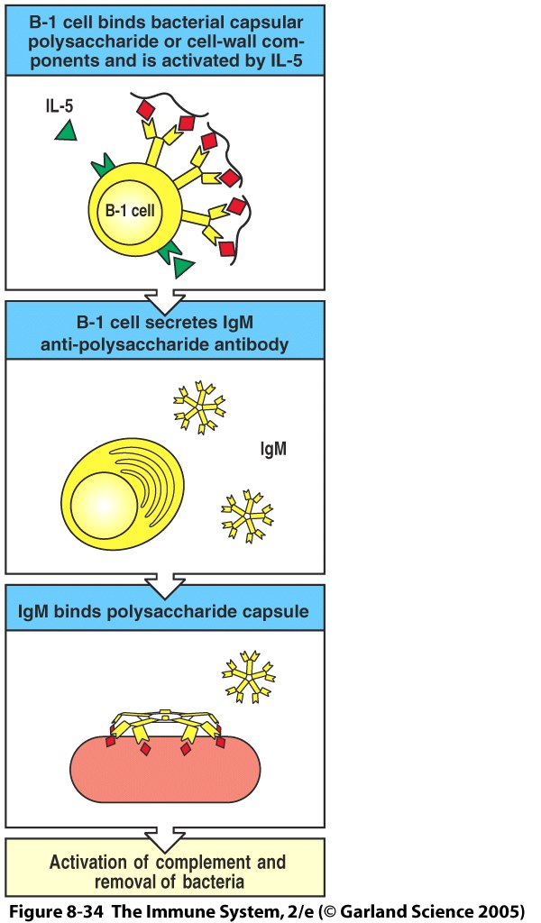
T independent
NO PROTEIN!!
Only IgM made!

Slide 15
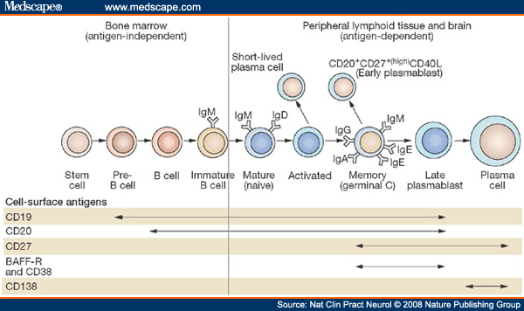
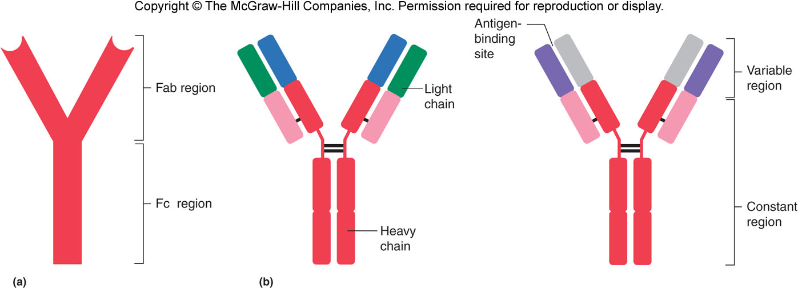
Antibodies!!!!

Slide 16
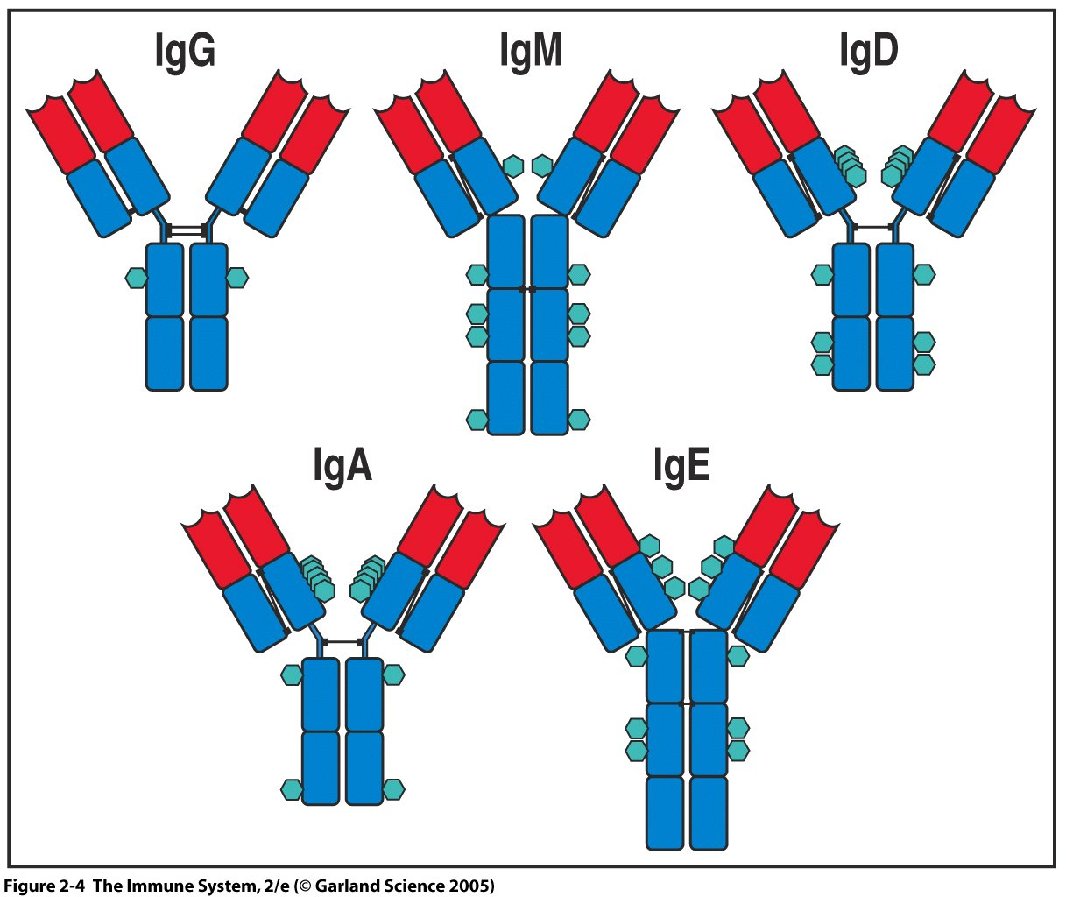

Slide 17
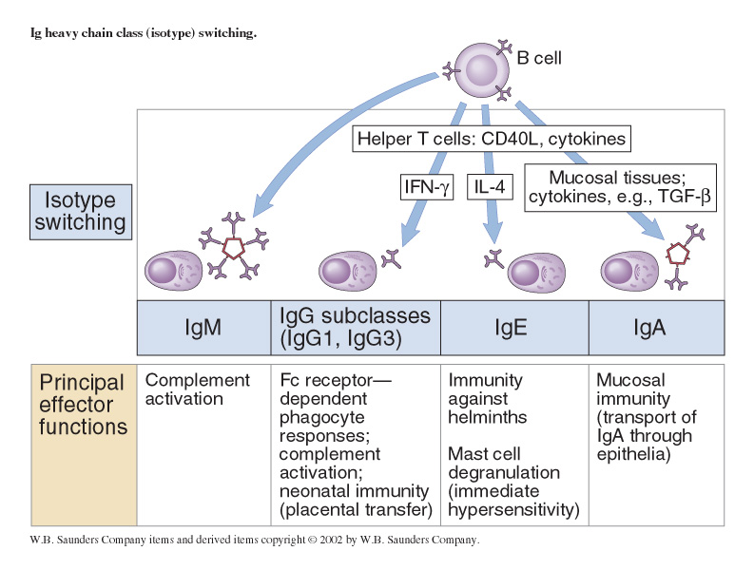

Slide 18
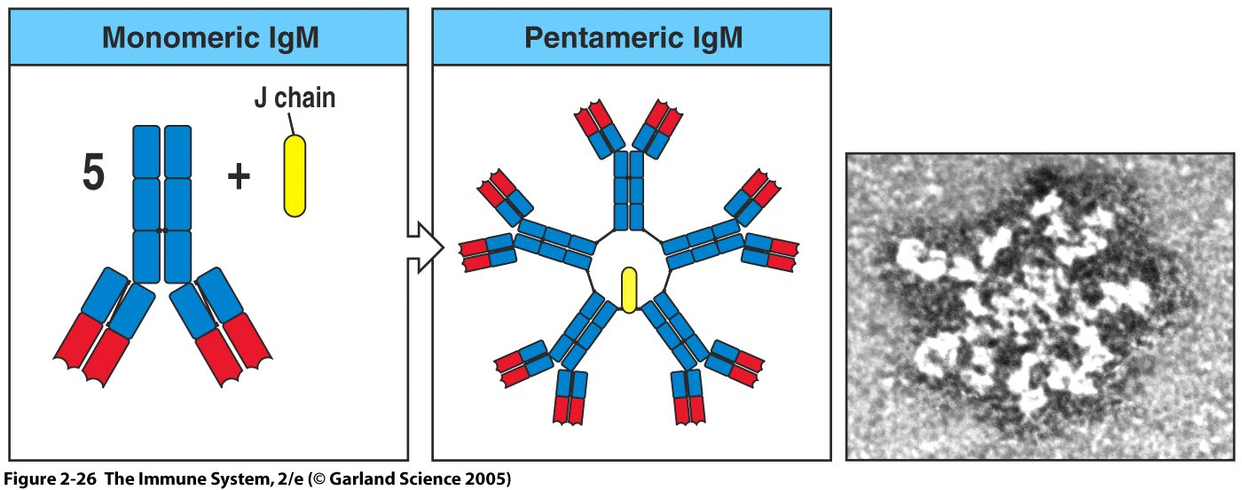

Slide 19
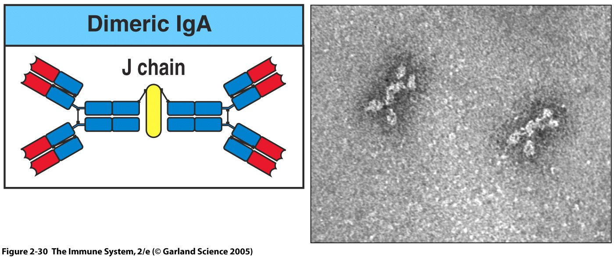

Slide 20
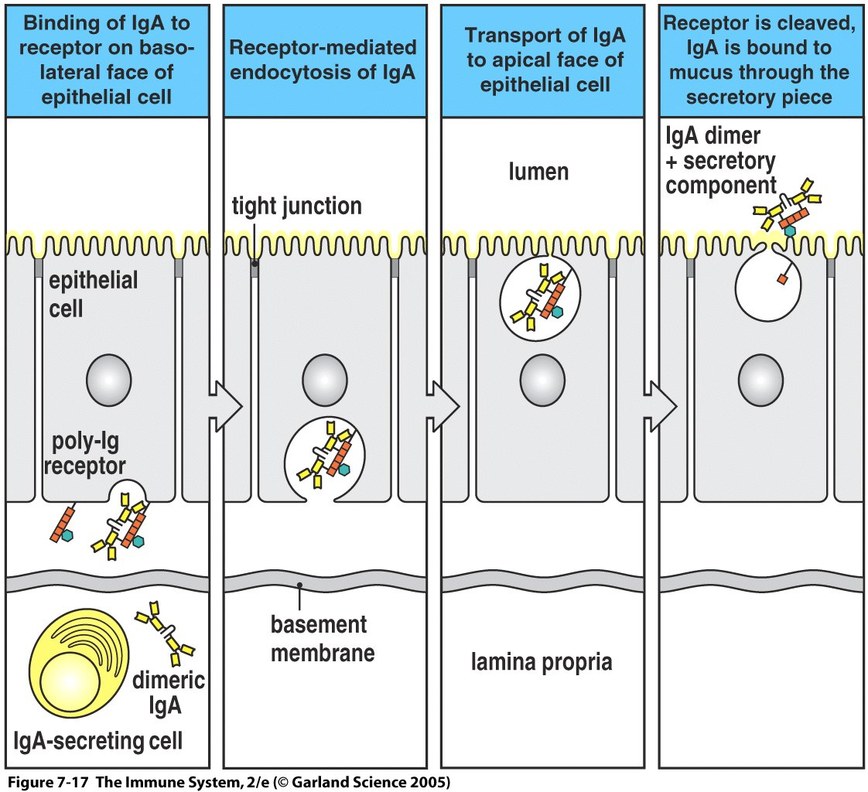
Figure 7-17

Slide 21
Memories….oh the memories-
B(m) cell

Slide 22
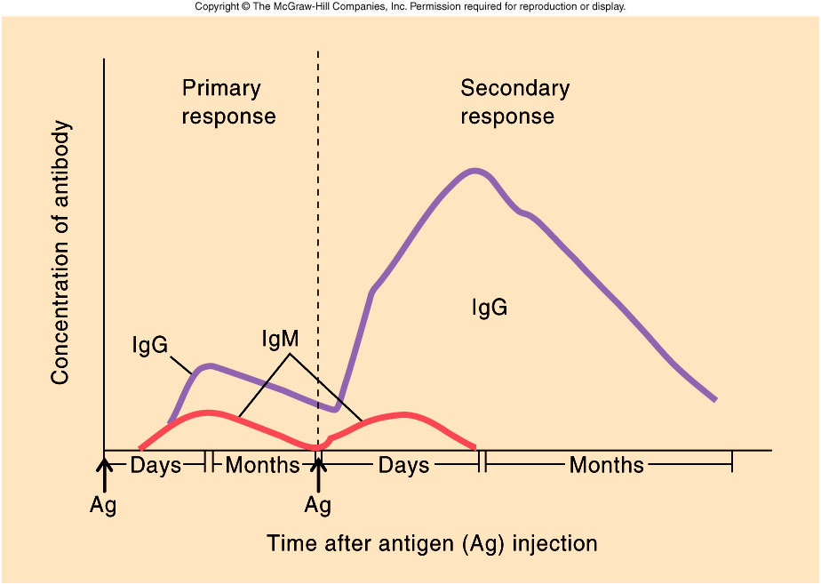

Slide 23
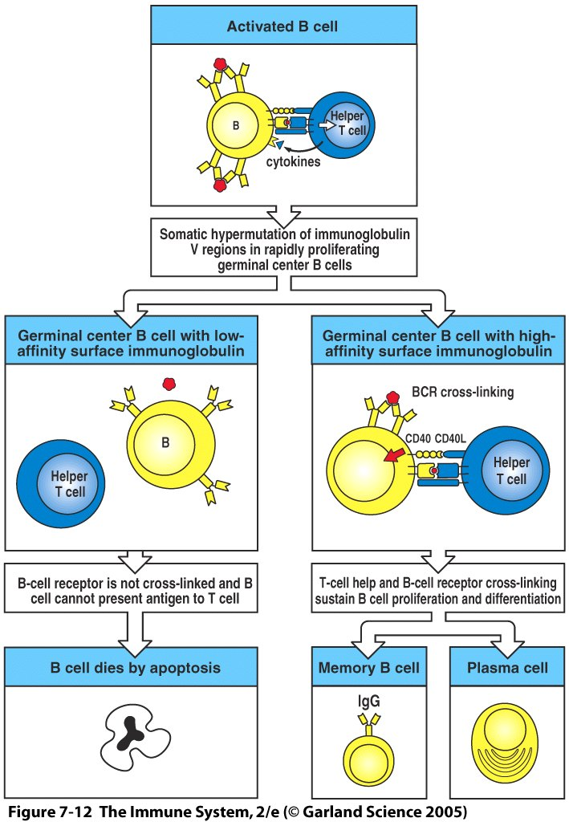
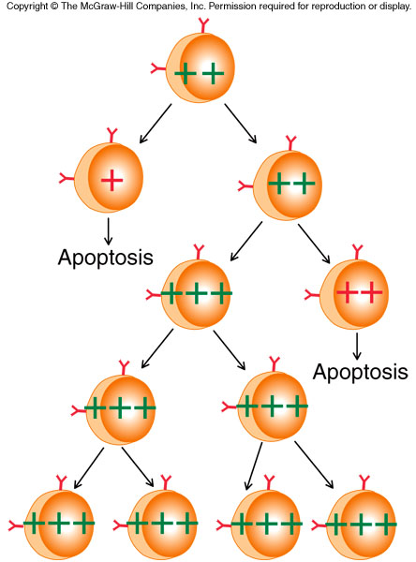

Slide 24
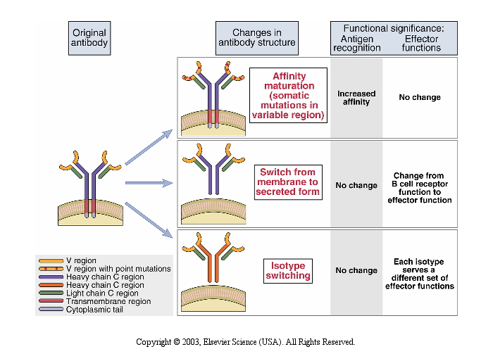

Slide 26
How do Antibodies get rid of pathogens?!?!

Slide 27
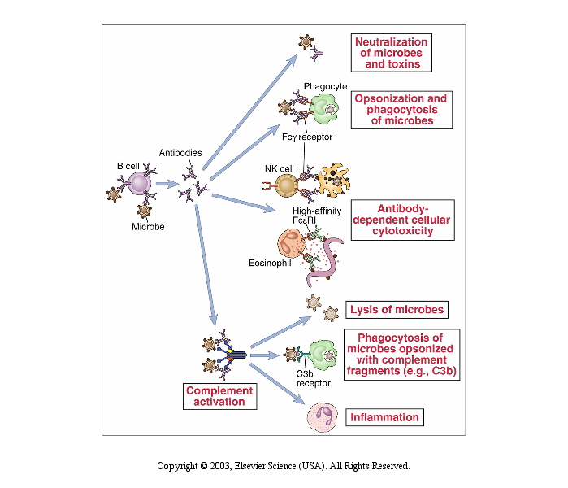
Antibodies work in so many different ways-

Slide 28
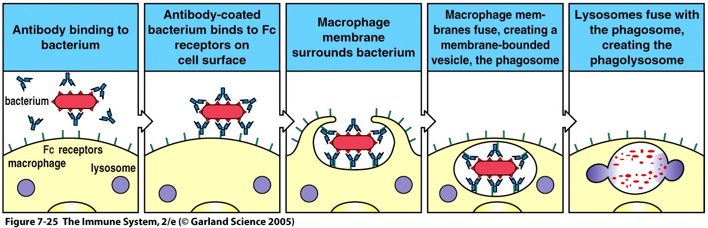
Figure 7-25

Slide 29
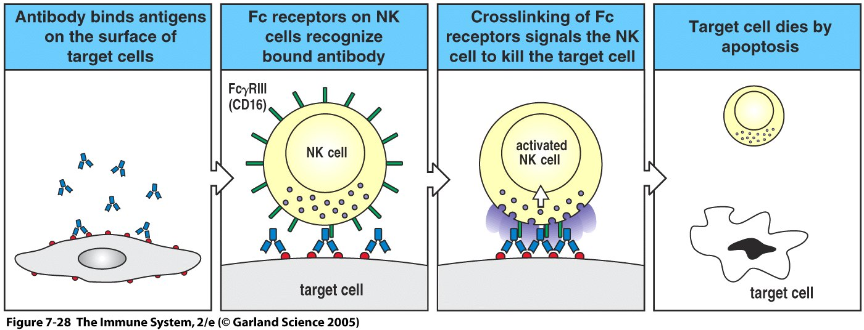
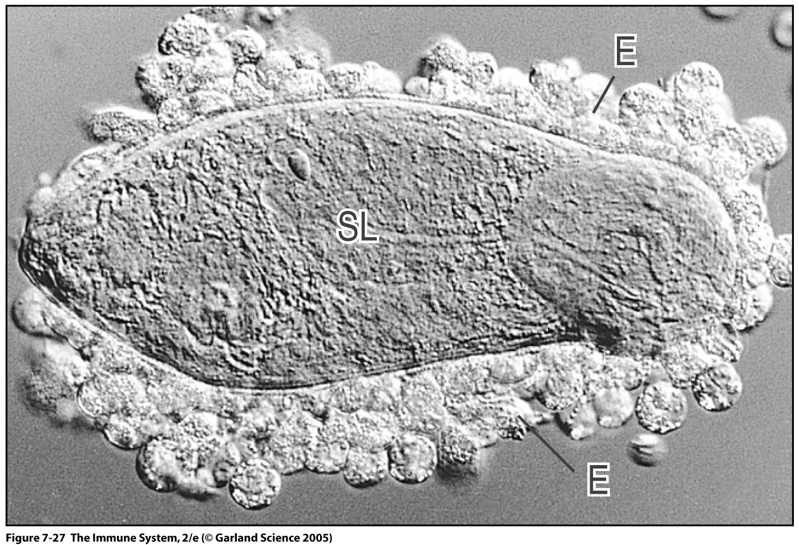
Figure 7-28

Slide 30
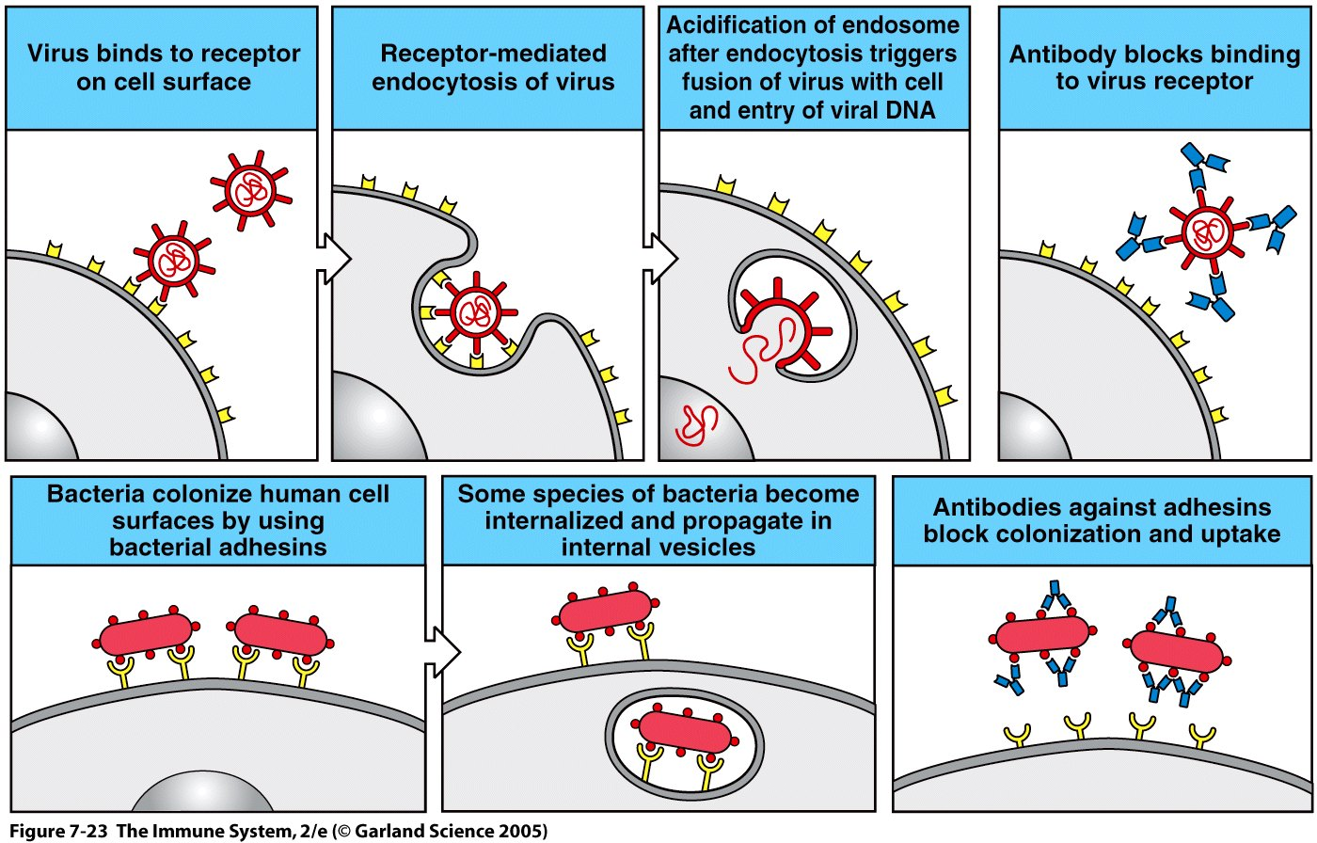
Figure 7-23

Slide 31
